Slide 1
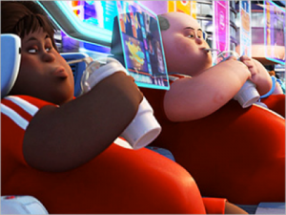
21ST Century Realities

Slide 2
The Backdrop:
Internet created in the 1960’s by the military industrial complex within the United States.
Designed to function without centralized control so that the system would still exist in the event of a military strike on a major city or region

Slide 3
Digital Anarchy
Interconnected design without centralized control functions much like a state of anarchy
Eric Schmidt, CEO of Google stated “the internet is the first thing that humanity has built that humanity doesn’t understand, the largest experiment in anarchy that we have ever had”
It is in this state of online anarchy that today’s students are coming of age and finding their way, largely on their own

Slide 4
Mark Prensky 2001
Digital Natives
young people who, after having been surrounded by digital technology since birth, employ an instinctive ability to understand and navigate through various digital media.
Digital Immigrants
adults who can remember the world before the digital revolution and must now learn the new language and customs of this new online world.

Slide 5
Just the facts!
Digital Natives
93 percent of young people aged 12 to 17 are online
18 percent increase in internet usage of children aged 2 to 17
only 1 in 5 teenagers had some form of Internet blocking software installed on their home computer
the average child between the ages of 8 and 18 spends 7 hours and 38 minutes online per day
With the rise of portable technology, many young people surf the web without parent oversight
Digital Immigrants
74 percent of American adults are online
Many feel that they do not possess the skills to adequately support students in this new environment and choose to remove themselves from the conversation
Many parents view their children as the house “guru” regarding the Internet and subsequently tolerate much more of their children’s increased screen time due to the perceived benefits of technical skill acquisition

Slide 6
Continued:
Digital Natives
2004 UK study found 7% of children considered themselves to be at the beginner level of comprehension of the Internet and computers
Digital Immigrants
2004 UK study found that 28% of parents considered themselves to be at the beginner level of comprehension of the Internet and computers
No central location for the home computer: also leads to unsupervised screen time

Slide 7
The Great Divide
Research shows there is a significant gap between children’s usage of technology, the skills associated and parental awareness

Slide 8
Unintended Consequences
many parents wrongly believed their child was unable to text strangers from an iPod because no phone number was assigned to that device.
countless free downloadable applications, such as text +, assign free telephone numbers to anyone, thereby allowing unsupervised children to access text, voice or video connectivity 24/7 through wireless Internet access at home or at school

Slide 9
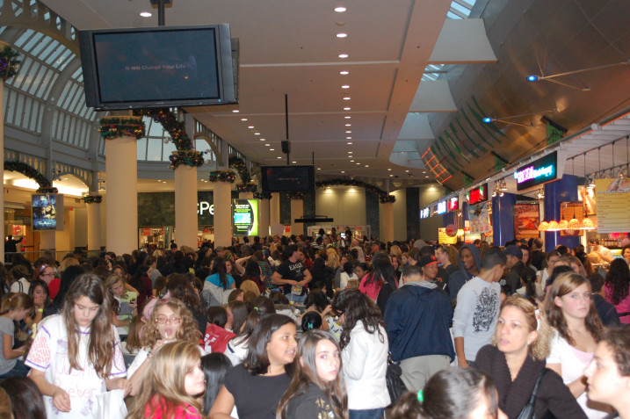
Social media sites are the “malls” for the 21st century child or adolescent
Facebook, Snapchat, Vine, and Instagram are used by youth to:
Socialize
catch up on gossip
collaborate on schoolwork
gain validation and engage in self-expression and identity formation typical to adolescence
A staggering 30 billion pieces of content is uploaded to Facebook every month

Slide 10
Benefits of Digital Socialization
Learning about the world beyond one’s sheltered environment
Being exposed to various possible interests
Developing civic engagement through the online support of causes that are meaningful to adolescents
Click here to view YOUTUBE video on Social Media

Slide 11
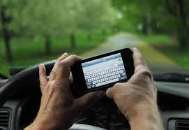
Text Messaging
The use of text messaging media has exploded in recent years with children and adolescents
Students text message each other to make plans, make quick comments online to small groups or to discuss homework, often whilst doing other things
students have created a new language through the use of acronyms, abbreviations, word combinations, emoticons and grammatical shortcuts to convey messages faster than formal language

Slide 12
2009 Study
Varnhagen et al.’s research found this new language aided in multitasking ability and dispelled parent and teacher concerns that this new language was eroding young people’s ability to write essays and formal communications

Slide 13
Interpersonal Communication Concerns
the implications surrounding the amount of text messaging and its effects upon interpersonal social skills are not fully known at this time
A recent Nielsen study reported the average American 13 to 17 year old exchanges 3,339 text messages per month, or around 111 per day
Given these statistics, it is no wonder that many parents and educators feel as if today’s children and adolescents are easily distractible due to their digital devices

Slide 14
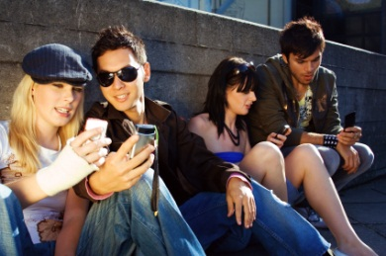
MIT professor of social science Sherry Turkle (2012) posits that constant use of digital media inhibits our capacity to give our full attention to an individual or to any singular task
While many teens use text messaging instead of actual face-to-face interactions, they are often deprived of important interpersonal cues such as of tone of voice and facial expressions
Since text messages are merely written symbols, the meaning and emotions within the message must be interpreted by the reader

Slide 15
Summing up:
Throughout history there has always been a lag between the introduction of a new technology and a set of behavioral and social norms that surround such technology
Adults must look to the modeling of the social norms within online communities as individuals learn values, styles of thinking and behaviors from extensive modeling within communities.
A significant amount of recent research indicates that many of these online communities do not provide a positive model for moral development
In fact, it is often these online communities that pose the greatest risks to adolescents’ mental health, personal safety and privacy

